Slide 1
GAMES!!
Ege Peksari
Christopher Ulrich

Slide 2
Battleship
The Good
The Bad
The UGLY

Slide 3
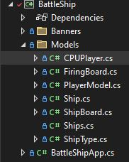
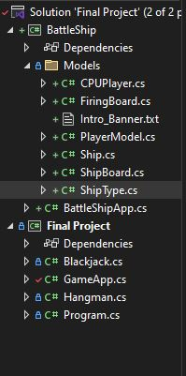
The GOOD : Classes

Slide 4
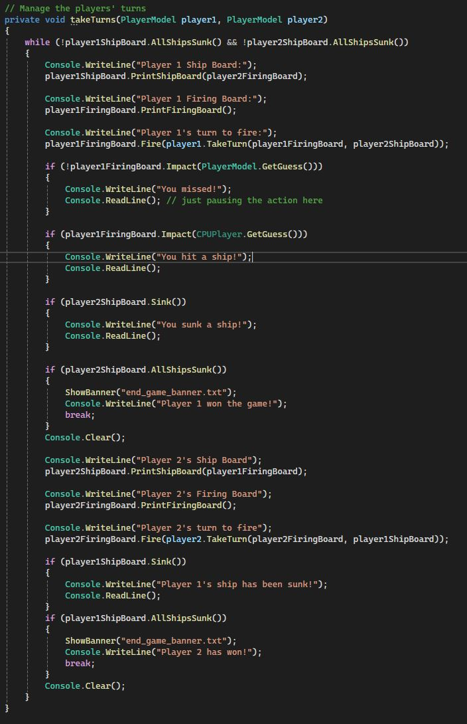
The good: loops

Slide 5
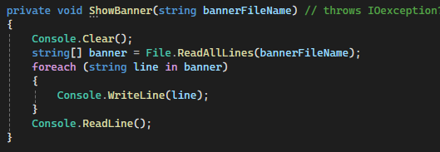
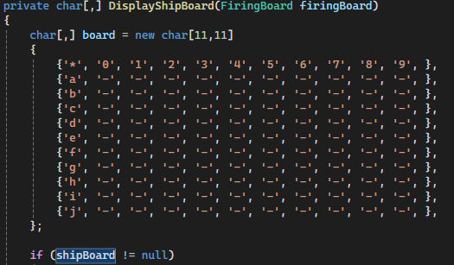
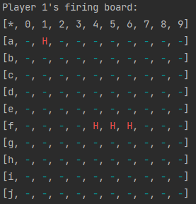
the good: File Read/Write & "GUI"

Slide 6
The good: Methods
Non-Void
Void
Instance
Static

Slide 7
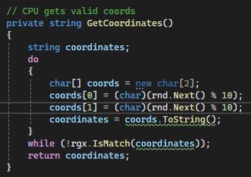
the good: RNGesus

Slide 8
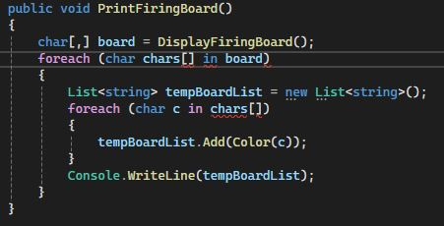
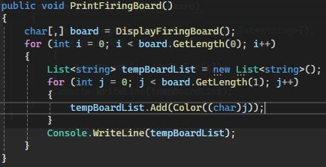
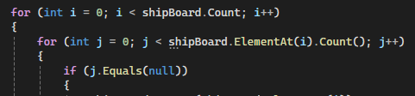
The BAD: loops
Notes:
Turns out there's no way to foreach through a 2d array in C#

Slide 9
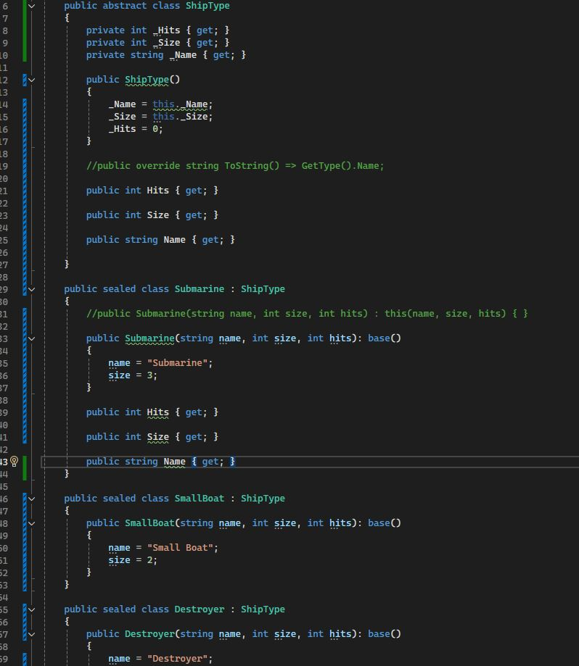
THE BAD: Constructors
Lots of repeated code

Slide 10
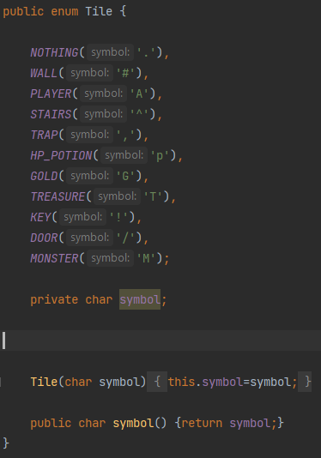
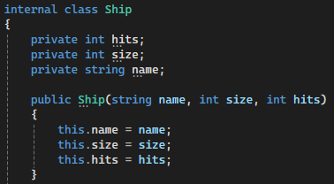

The UGLY: Enums & INHERITANCE

